Slide 1
A crucial skill in R coding/programming:
Merging of data sets
Tobias Niedermaier

Slide 2
Background
Sometimes, data sets are HUGE and contain hundreds, if not thousands of variables (columns).
The researcher will only get a small part of the data set, i.e. only the variables that he needs for his analysis.
Then maybe he figures out that he needs additional data and receives an additional (partial) data set with further variables.
Now he needs to merge them so that he has one big data set to work with.

Slide 3
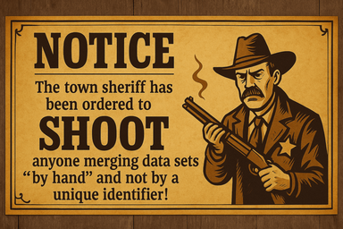


DOs and DON‘Ts
DOs:
In every (partial) data set, there must be a unique identifier (ID) for every patient/subject.
You don‘t need to sort any of the (partial) data sets before merging them.
Even the column (variable) name of the identifier does not need to be the same in the two (or more) data sets. Use merge().
DON‘Ts:
Merging participants “by hand” in the
order in which they appear in the data set.
Sorting the data sets first and then merge them “by hand” or any other kind of “manual” merging.

Slide 4
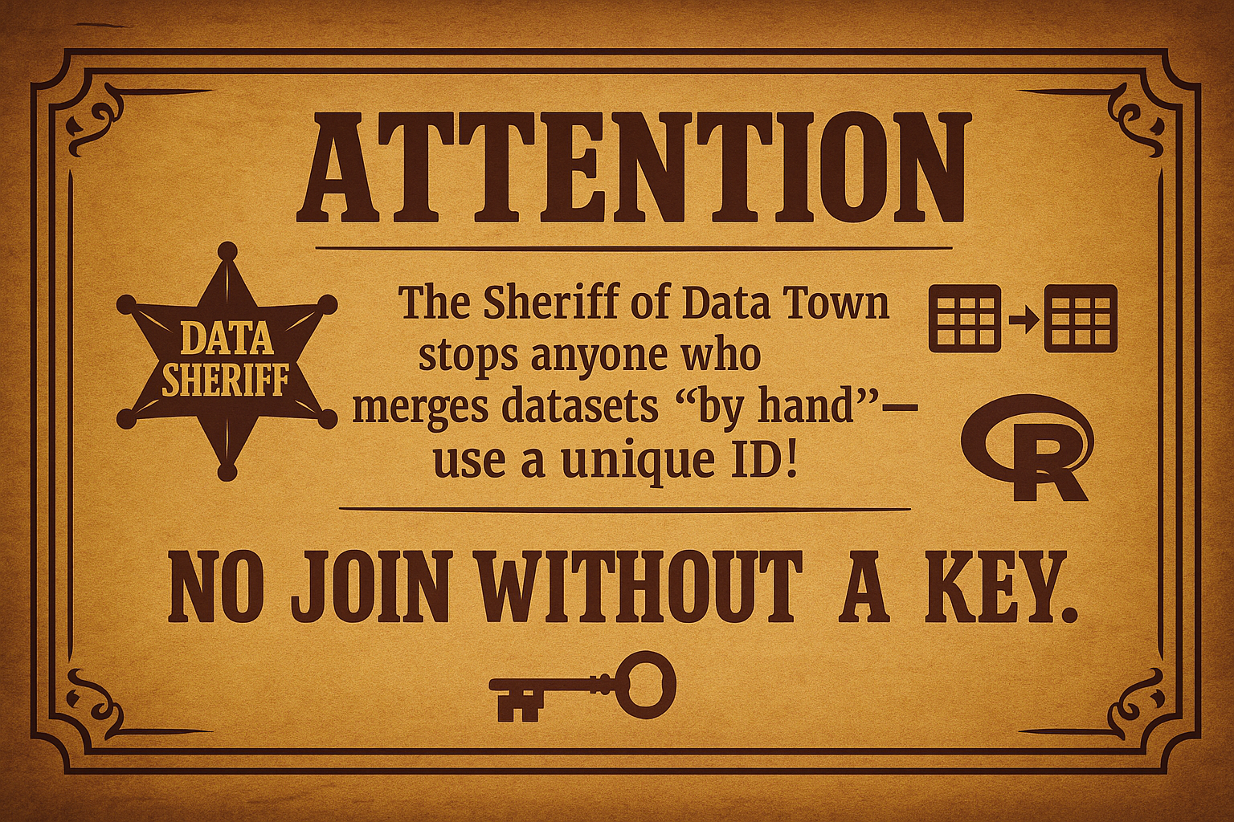
DOs and DON‘Ts
DOs:
In every (partial) data set, there must be a unique identifier (ID) for every patient/subject.
You don‘t need to sort any of the (partial) data sets before merging them.
Even the column (variable) name of the identifier does not need to be the same in the two (or more) data sets. Use merge().
DON‘Ts:
Merging participants “by hand” in the
order in which they appear in the data set.
Sorting the data sets first and then merge them “by hand” or any other kind of “manual” merging.

Slide 5
Merging in practice
With identical identifiers: | With different identifiers:
dat <- mtcars
dat1 <- dat[,c(1:6)]
dat2 <- dat[,c(7:11)]
dat1 <- data.frame(ID=1:32, dat1)
dat2 <- data.frame(ID=1:32, dat2)
dat_merged <- merge(dat1, dat2, by="ID")
dat <- mtcars
dat1 <- dat[,c(1:6)]
dat2 <- dat[,c(7:11)]
dat1 <- data.frame(ID=1:32, dat1)
dat2 <- data.frame(id=1:32, dat2)
dat_merged <- merge(dat1, dat2, by.x="ID", by.y="id")

